Slide 1

Introduction to Cyber Security | 19EAC401
NeuroEdge: Energy-Efficient Anomaly Detection for Edge Cybersecurity Using Neuromorphic Computing
Team members:
Lasyapriya Bharadwaj K - BL.EN.U4EAC22033
Shashank R - BL.EN.U4EAC22047
Faculty:
Mr. Sagar B.
Assistant Professor (Sr. Gd.)

Slide 2
CONTENTS
01
INTRODUCTION
06
METHODOLOGY
02
MOTIVATION
07
RESULTS AND DISCUSSION
03
OBJECTIVES
08
LIMITATIONS AND FUTURE WORK
04
LITERATURE SURVEY
09
CONCLUSION
05
SUMMARY OF LITERATURE SURVEY
10
LIST OF REFERENCES

Slide 3
INTRODUCTION
The project addresses the rapidly expanding field of Internet of Things (IoT) network security, a domain increasingly vulnerable due to the proliferation of connected devices, forecasted to reach nearly 80 billion globally by 2024.​ [1]
IoT networks are exposed to sophisticated attacks such as botnets, DDoS, reconnaissance, data theft, and keylogging, which can lead to severe breaches and operational disruption.​​ [1]
The Bot-IoT dataset forms the backbone of experimental setup, containing over 72 million records spanning various attacks and benign network traffic.​​ [2]
Analysis of the Bot-IoT dataset shows extreme imbalance—common attacks vastly outweigh normal traffic, e.g., a 1:4038 ratio for certain major attacks—posing a significant challenge for accurate, generalizable detection.​​ [2]
The project aims to design and implement a real-time Intrusion Detection System (IDS) leveraging Spiking Neural Networks (SNN) and classical ensemble classifiers for robust IoT defense.​
SNNs are biologically inspired neural models that process network data in an energy-efficient, event-driven manner, ideal for resource-constrained IoT deployments.​​

Slide 4
INTRODUCTION contd.
The system pipeline includes preprocessing (feature selection, encoding, normalization), dataset balancing/augmentation (using SMOTE for minority class support), multi-model training, and live prediction using edge device simulations.​
Normal and attack traffic are generated in realistic conditions via containerized edge devices and host-based attack simulations, ensuring diversity and reliability for model evaluation.​
Prediction results are visualized in real time through a responsive dashboard, providing actionable alerts and network analytics to security analysts.​
The project delivers high classification accuracy for both attack and benign traffic—SNN reaches over 96% F1-score after augmentation, while ensemble models exceed 99% on balanced datasets.​
This framework advances existing research by overcoming class imbalance and operational constraints, supporting practical IDS deployment in modern IoT networks.

Slide 5
MOTIVATION
The exponential growth of Internet of Things (IoT) devices—forecasted to reach 80 billion by 2024—has dramatically expanded the attack surface for cyber threats in modern networks. [1]
IoT botnet attacks cause massive security breaches and operational disruptions, highlighting the urgent need for adaptive, scalable intrusion detection systems tailored to heterogeneous smart environments.
Conventional Intrusion Detection Systems (IDS) often struggle to balance high detection rates with low false positives, especially given class imbalance and realistic deployment scenarios. [3]
This project addresses these gaps with an advanced framework integrating Spiking Neural Networks (SNN) and ensemble classifiers for robust IoT security.

Slide 6
OBJECTIVE
To design and implement an energy-efficient anomaly detection system for IoT edge devices using neuromorphic computing. By leveraging spiking neural networks (SNN), the system will detect cyber threats in real-time with minimal power consumption, ensuring scalability and resilience for resource constrained environments.
SUB-OBJECTIVES
To preprocess and convert cybersecurity datasets into event-based formats compatible with spiking neural networks (SNNs) for efficient anomaly detection.
To design and train SNN models to classify network anomalies with high accuracy, leveraging neuromorphic simulation tools.
To integrate the SNN-based detection system with emulated IoT edge devices to process live data streams in real-time.
To optimize the system for low power consumption through sparse computation techniques, targeting sub-operation.
To develop a lightweight dashboard for visualizing anomalies and deploy the system in a containerized environment for scalability.

Slide 7
LITERATURE SURVEY
1. Khaleefah et al., Informatica, 2023 – “Detection of IoT Botnet Cyber Attacks using ML”
Explores detection of botnet cyber attacks using classical ML models on the Bot-IoT dataset, highlighting the skewed nature of attack types and the challenges of achieving class balance.
Key findings suggest high performance for majority attack classes, but significant shortcomings for normal and rare samples.
The study stops short of energy-efficient modeling and does not leverage neuromorphic approaches.
2. Rahman et al., Elsevier, 2025 – “A survey on intrusion detection system in IoT networks”
This paper presents a comprehensive survey of intrusion detection systems, focusing on the architecture and deployment scenarios for IoT environments.
Key contributions include a taxonomy of IDS approaches (signature-based, anomaly-based, and hybrid), evaluation of their advantages and limitations for resource-constrained IoT devices, and analysis of best practices in anomaly detection.
Notably, the authors emphasize the difficulty of balancing detection accuracy against operational constraints such as latency and battery life in large-scale IoT deployments.
A limitation is the lack of coverage on the use of neuromorphic models like Spiking Neural Networks (SNN), which have shown energy efficiency and adaptability in recent research.
3. Amine et al., Nature, 2025 – “Improved model for intrusion detection in the Internet of Things”
The authors develop advanced deep learning architectures for IoT IDS, arguing for their superior accuracy and generalization.
The model leverages convolutional layers for feature extraction and Gated Recurrent Units (GRUs) for learning temporal patterns in network traffic.
Experimental results demonstrate that the proposed framework outperforms traditional classifiers on multiple synthetic IoT datasets.
However, scalability and validation across diverse, real-world IoT networks remain unresolved, restricting practical deployment.

Slide 8
LITERATURE SURVEY
4. Alosaimi and Almutairi, Appl. Sci., 2023 – “An Intrusion Detection System Using BoT-IoT”
Proposes a multi-level AI-based IDS using ML classifiers (DT, Ensemble Bag, KNN, LDA, SVM) evaluated on various BoT-IoT dataset formats.
Employs data reduction and SMOTE balancing to address class imbalance.
Reports accuracy above 99.8% for most attacks and best performance with ensemble bagging classifier.
Bridges data preprocessing, labeling, and multi-level classification with practical detection in IoT botnets.
5. Sharma et al., IEEE, 2025 – “Leveraging AI for Intrusion Detection in IoT Ecosystems”
Sharma et al. review the range of AI and machine learning techniques employed for IoT intrusion detection, covering supervised, unsupervised, and reinforcement learning approaches.
They note the progress made in anomaly detection and attack classification but highlight persistent challenges such as imbalanced traffic and deployment complexity.
The survey lacks in-depth discussion of neuromorphic computing and notably does not cover SNNs.
6. Qaddos et al., Nature, 2024 – “Hybrid CNN-GRU framework for IoT IDS”
This paper tackles IoT network intrusion detection with a novel hybrid deep learning framework combining CNN and GRU, aiming to exploit both spatial and sequential relationships.
Experimental evidence shows that the hybrid approach yields strong F1-measure and precision scores on synthetic attack scenarios.
The reliance on synthetic, non-standardized datasets is a weakness, and benchmarking against public datasets like Bot-IoT or NSL-KDD is missing.

Slide 9
LITERATURE SURVEY
7. Wang et al., Nature, 2024 – “An efficient intrusion detection model based on SNNs”
The study validates Spiking Neural Networks as effective for intrusion detection, comparing their performance against deep and classical machine learning models on NSL-KDD and AWID datasets.
SNNs are shown to surpass conventional classifiers in terms of both accuracy and efficiency.
Methodological gaps include limited adaptation to nonlinear realistic attack traffic and absence of incremental, real-time learning evaluation.
8. Yarga and Wood, Frontiers in Neuroscience, 2024 – “Direct training of deep spiking neural networks”
Presents parallelized, event-driven spiking neural models for dynamic processing, arguing their applicability to distributed edge security tasks.
Shows that deep SNNs can learn temporal and frequency features critical for anomaly recognition and alerting.
However, IoT-scale validation and rigorous benchmarking are areas left for future work.
9. PM Rahman et al., PubMed, 2023 – “Exploring spiking neural networks: analysis and limitations”
An in-depth review of the theoretical foundations and computational limitations of SNNs.
Highlights strengths—such as biological plausibility and temporal encoding—as well as the difficulties in selecting optimal architectures and maintaining robustness against novel attacks.
Biological realism is a double-edged sword, leading to complexity in model design and deployment.
10. Manivannan et al., Elsevier, 2024 – “Recent endeavors in ML-powered IDS for IoT”
Surveys recent machine learning IDS solutions, including deep and classical models, emphasizing trends in explainability, minority class handling, and online learning.
Identifies core gaps in hybrid techniques, deployment in highly dynamic IoT networks, and real-time integration of adaptive models.

Slide 10
SUMMARY OF LITERATURE SURVEY
Paper | Authors (et al.) | Publisher | Contribution | Dataset/Methodology | Limitations/Gaps
“Botnet Attack ML Detection” [1] | Khaleefah et al. | Informatica | ML model performance on Bot-IoT | Bot-IoT dataset, ML | Weak on rare/normal sample detection, lacks SNN
“IDS in IoT Networks” [3] | Rahman et al. | Elsevier | Taxonomy and survey of IDS architectures | Review, Multi-dataset | Ignores neuromorphic (SNN) models, lacks edge focus
“DL Models for IoT IDS” [4] | Amine et al. | Nature | Deep learning for accurate detection | GRU+CNN, Synthetic | Unproven scalability on real IoT, limited benchmarks"
"IDS Using BoT-IoT" [5] | Alosaimi and Almutairi | Appl. Sci. | ML-based multi-level IDS with dataset balancing | BoT-IoT variants | Dataset reduction, practical performance focus
“AI IDS Survey” [6] | Sharma et al. | IEEE | Review of AI/ML techniques for IDS | Literature survey | No SNN, missing deployment details
“Hybrid CNN-GRU IDS” [7] | Qaddos et al. | Nature | CNN-GRU hybrid, spatial+temporal modeling | Synthetic IoT | No Bot-IoT/NSL-KDD benchmarking
“SNN Model for IDS” [8] | Wang et al. | Nature | SNN vs. deep/classical for IDS | SNN, NSL-KDD, AWID | No real-time learning, adaptation gaps
“Training Deep SNNs” [9] | Yarga, Wood et al. | Frontiers | Event-driven SNN, temporal anomaly detection | Simulation, Edge | Not validated for IoT-scale
“Analysis of SNNs” [10] | PM Rahman et al. | PubMed | Mathematical analysis and limits of SNNs | Theoretical study | Model selection, new attack adaptation
“ML IDS for IoT Trends” [11] | Manivannan et al. | Elsevier | ML survey—explainability, imbalance, online | Survey, multiple | Hybrid, real-time deployment gap

Slide 11
SUMMARY OF LITERATURE SURVEY contd.
Synthesis & Further Observations
The literature highlights rapid progress for IoT IDS solutions, especially hybrid deep learning and neuromorphic algorithms, but also documents persistent open challenges:
Imbalanced datasets and poor performance on minority and normal classes hinder real-world applicability.​
Scalability and energy consumption concerns dominate feasibility discussions for large-scale IoT, where battery and computational resources are constrained.​
Generalization across real deployments is frequently limited by the synthetic nature of laboratory datasets, necessitating better real-world modeling and adaptation strategies.​
Neuromorphic models (SNNs), although promising for energy efficiency and temporal data, are still under-explored in IoT-scale, real-time operational settings.​
Hybrid and ensemble models—combining classical and neuromorphic approaches—are recommended for improved accuracy, energy savings, and adaptability to emerging threats.
Project-Specific Solution
This project directly addresses several challenges from the survey:
Uses advanced balancing (SMOTE), augmentation, and ensemble methods to boost minority class and normal traffic classification.​
Implements Spiking Neural Networks and classical models jointly for robust, adaptable intrusion detection with greater operational energy efficiency.​
Fuses real-time prediction, containerized edge device simulation, and interactive dashboards, providing practical, scalable IoT security.​
These contributions fill important gaps in both academic literature and operational cybersecurity, marking the project’s value in the ongoing evolution of IoT intrusion detection systems.

Slide 12
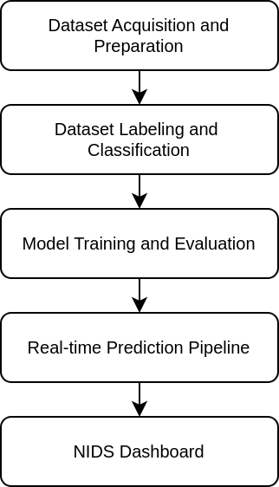
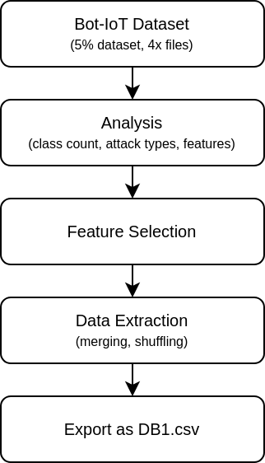
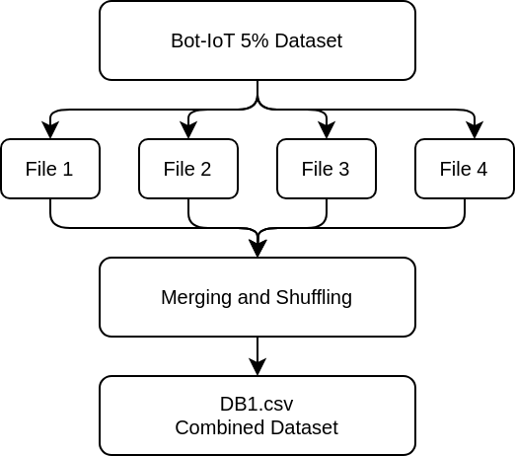
METHODOLOGY
Overall System Block Diagram
Data Acquisition and Preparation
Combined Dataset Creation

Slide 13
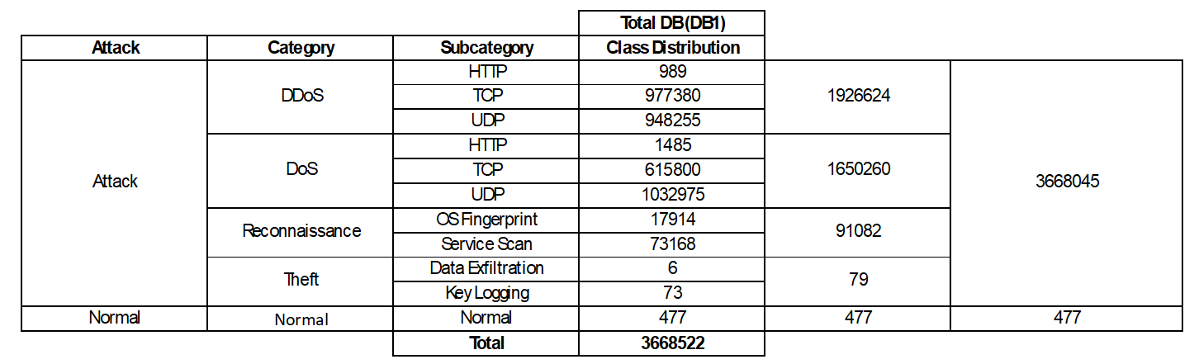
METHODOLOGY
Data Acquisition and Preparation
Attack category and subcategory-wise class distribution in DB1.
Feature Selection
Only core numerical and protocol features were retained (e.g., proto, flgs, ports, pkt/byte counts, rate features).
Redundant and non-generalizable attributes (IP addresses, packet IDs, and derived columns) were dropped to improve efficiency and prevent model overfitting.
This selection process ensured a compact and informative feature set for real-time, scalable intrusion detection.
Combining the Category and Subcategory target labels to create a new target label Category_Subcategory.

Slide 14
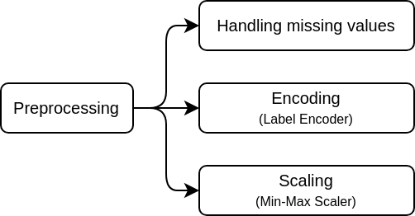
METHODOLOGY
Dataset Labeling and Classification Setup
Creation of DB2
Creation of DB2 by randomly sampling DB1, reducing the dataset from approximately 3.7 million to 63,030 records.
A cap of 10,000 was set for all the target labels, targets with less samples were retained completely.
Data Preprocessing
Missing values were filled with zero to ensure all feature columns were numerical.
Label encoding was applied to the label column using a LabelEncoder, which was saved for reuse during inference.
Min-Max scaling was applied to normalize all numerical features to a 0–1 range using a Min-Max Scaler. The scaler object was saved for real-time scaling during prediction.

Slide 15
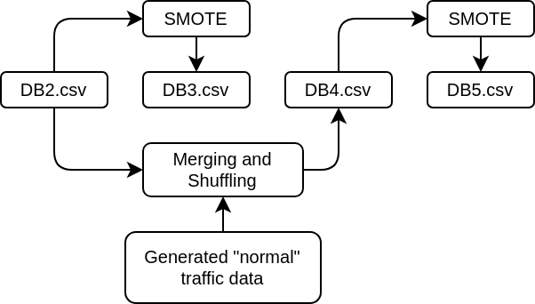
METHODOLOGY
Dataset Labeling and Classification Setup
Creation of DB3
Derived from DB2 using the Synthetic Minority Over-sampling Technique (SMOTE) to balance classes. Major classes were set to 10,000 samples, while minor classes received proportionally smaller targets.
Creation of DB4
Built by augmenting the scarce normal class with 10,000 synthetically generated normal traffic vectors, compensating for the initially low count ( 477 rows). Other classes retained their original imbalance.
Creation of DB5
Combined DB4’s augmented normal class data with SMOTE balancing applied to attack classes—merging realistic normal traffic samples with balanced attack representation.

Slide 16
METHODOLOGY
Dataset Labeling and Classification Setup
Class Distribution of DB2, DB3, DB4 and DB5
Label | DB2.csv | DB3.csv | DB4.csv | DB5.csv
DDoS HTTP | 989 | 10000 | 989 | 10000
DDoS TCP | 10000 | 10000 | 10000 | 10000
DDoS UDP | 10000 | 10000 | 10000 | 10000
DoS HTTP | 1485 | 10000 | 1485 | 10000
DoS TCP | 10000 | 10000 | 10000 | 10000
DoS UDP | 10000 | 10000 | 10000 | 10000
Reconnaissance OS Fingerprint | 10000 | 10000 | 10000 | 10000
Reconnaissance Service Scan | 10000 | 10000 | 10000 | 10000
Theft Data Exfiltration | 6 | 100 | 6 | 100
Theft Key Logging | 73 | 500 | 73 | 500
Normal | 477 | 10000 | 10000 | 10000
Total | 63030 | 90600 | 72553 | 90600

Slide 17
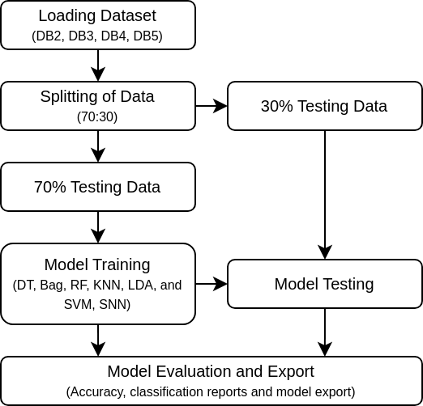
METHODOLOGY
Model Training and Evaluation
Training and Evaluation Setup
Several classical machine learning models were trained and evaluated on the processed datasets: Decision Tree, Bagging Classifier, Random Forest, K-Nearest Neighbors, Linear Discriminant Analysis, and Support Vector Machine.
The dataset was split randomly into 70% training and 30% testing subsets
The SNN model was then implemented to leverage neuromorphic computing principles. The SNN architecture used fully connected layers with Leaky Integrate-and-Fire (LIF) neuron models.

Slide 18
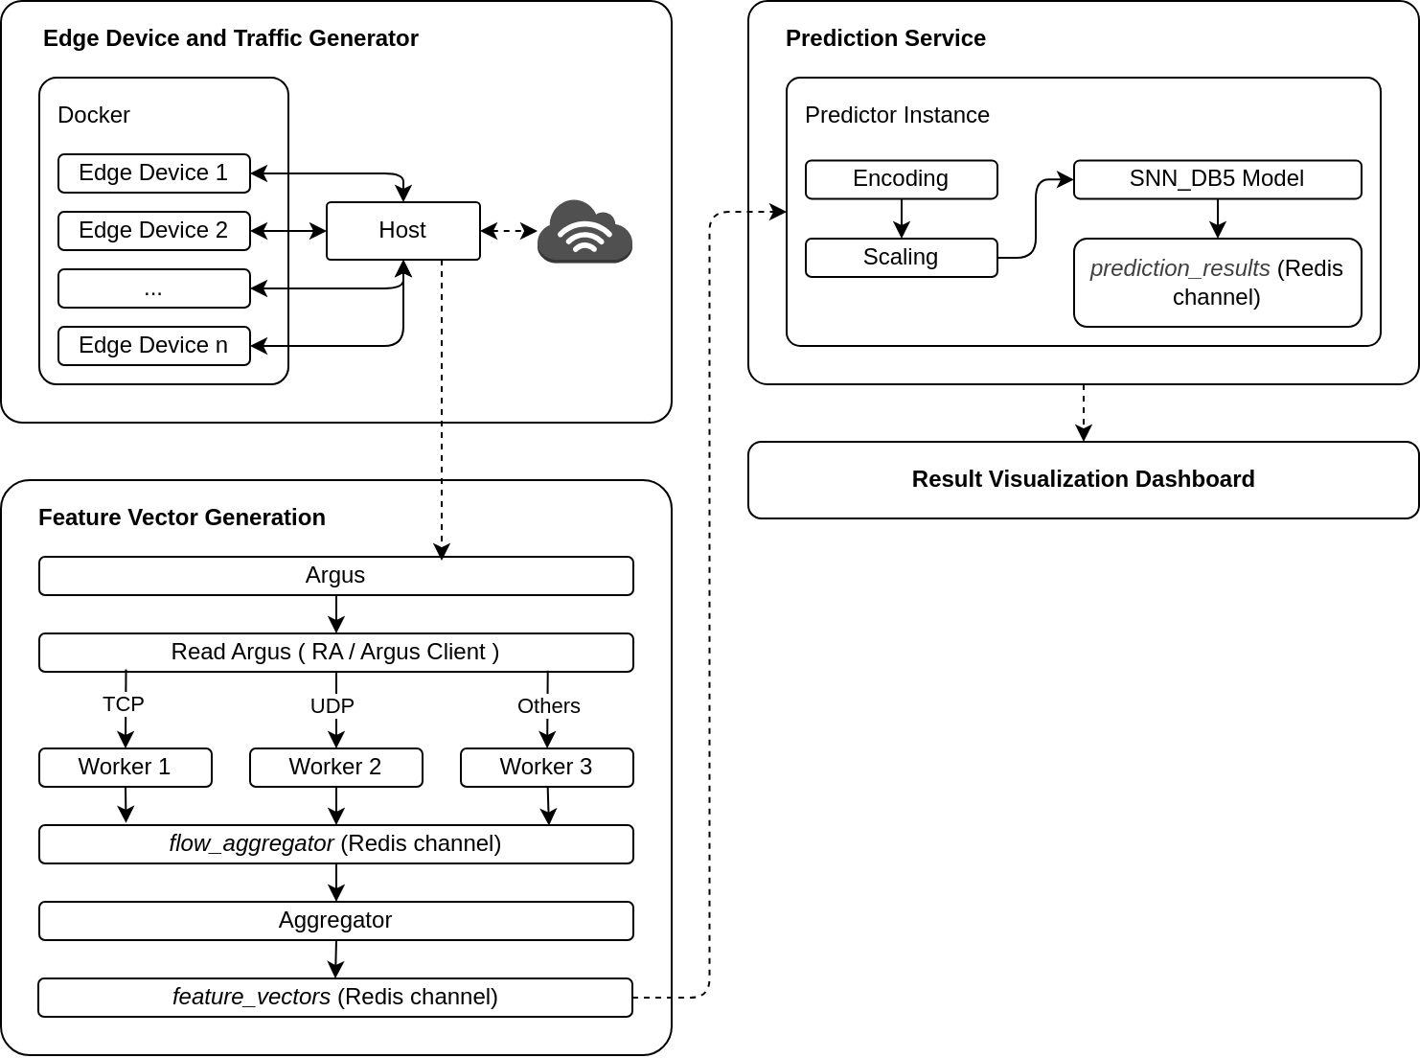
METHODOLOGY
Real-time Prediction Pipeline
This pipeline contains 4 main stages
Edge Device and Traffic Generator
Feature Vector Generation
Predictor Instance
Result Visualization Dashboard

Slide 19
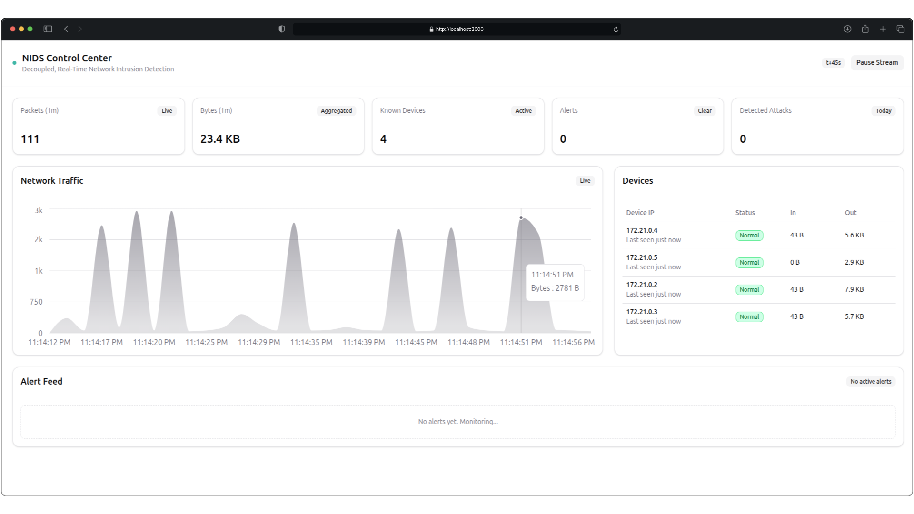
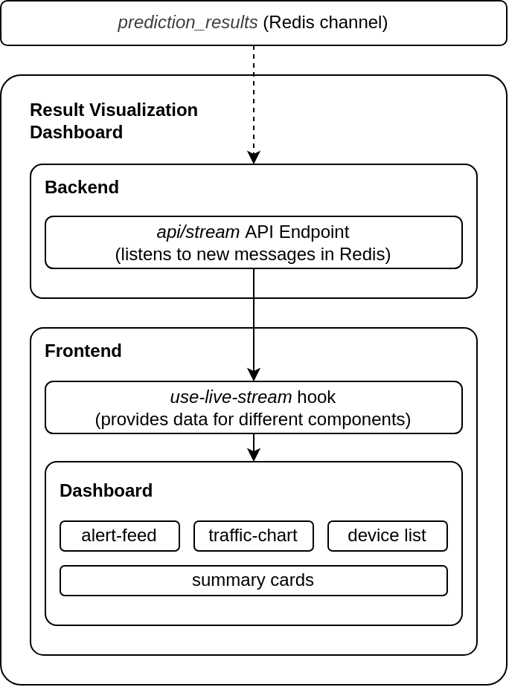
METHODOLOGY
Result Visualization Dashboard

Slide 20
RESULTS AND DISCUSSION
Model Performance Evaluation - DB2
Model | Accuracy | Precision | Recall | F1-Score | Time (s)
Decision Tree Classifier | 0.998 | 1 | 1 | 1 | 0.3897
Ensemble Bagging Classifier | 0.9983 | 1 | 1 | 1 | 3.3444
Random Forest Classifier | 0.999 | 1 | 1 | 1 | 1.6932
K-Nearest Neighbors | 0.9455 | 0.95 | 0.95 | 0.95 | 1.1118
Linear Discriminant Analysis | 0.6136 | 0.67 | 0.61 | 0.59 | 0.1376
Support Vector Machine | 0.7158 | 0.75 | 0.72 | 0.7 | 364.2769
Spiking Neural Network | 0.9327 | 0.94 | 0.93 | 0.93 | 45.5894
On DB2, tree-based models (DT, Bagging, RF) achieve perfect 1.00 precision, recall, and F1- scores with fast training times, demonstrating effectiveness on imbalanced datasets with strong feature separability. KNN also performs well at 95% across metrics.
However, LDA and SVM underperform (F1: 0.59 and 0.70) due to class imbalance and non-linear patterns. SNN achieves 93% accuracy and F1-score but shows lower recall for normal traffic, often misclassifying normal samples as DDoS TCP or DDoS HTTP.

Slide 21
RESULTS AND DISCUSSION
Model Performance Evaluation - DB3
Model | Accuracy | Precision | Recall | F1-Score | Time (s)
Decision Tree Classifier | 0.9982 | 1 | 1 | 1 | 1.0804
Ensemble Bagging Classifier | 0.9987 | 1 | 1 | 1 | 7.2497
Random Forest Classifier | 0.999 | 1 | 1 | 1 | 3.9382
K-Nearest Neighbors | 0.9611 | 0.96 | 0.96 | 0.96 | 2.3949
Linear Discriminant Analysis | 0.6062 | 0.66 | 0.61 | 0.6 | 0.223
Support Vector Machine | 0.7547 | 0.8 | 0.75 | 0.74 | 693.8833
Spiking Neural Network | 0.937 | 0.94 | 0.94 | 0.94 | 63.9671
Tree-based models (DT, Bagging, RF) maintain perfect 1.00 scores with minimal training time increases. KNN improves to 96% across metrics, reducing majority class bias. LDA and SVM underperform (F1: 0.60, 0.74), struggling with multi-class complexity.
SNN benefits from balanced distribution, achieving 94% accuracy and F1-score with fewer misclassifications of normal traffic and rare classes.

Slide 22
RESULTS AND DISCUSSION
Model Performance Evaluation - DB4
Model | Accuracy | Precision | Recall | F1-Score | Time (s)
Decision Tree Classifier | 0.998 | 1 | 1 | 1 | 0.4593
Ensemble Bagging Classifier | 0.9984 | 1 | 1 | 1 | 3.4666
Random Forest Classifier | 0.999 | 1 | 1 | 1 | 1.8228
K-Nearest Neighbors | 0.9422 | 0.94 | 0.94 | 0.94 | 0.9974
Linear Discriminant Analysis | 0.7734 | 0.79 | 0.77 | 0.77 | 0.1729
Support Vector Machine | 0.8303 | 0.86 | 0.83 | 0.83 | 232.1613
Spiking Neural Network | 0.9578 | 0.96 | 0.96 | 0.96 | 50.592
SNN and KNN show the most notable gains, with F1-scores rising to 0.96 and 0.94. Tree-based models achieve perfect 1.00 scores. This marks a key turning point: misclassification of normal flows as attacks drops drastically. LDA performance jumps to 0.77 F1, and SVM’s F1 climbs to 0.83.
Overall, DB4 demonstrates that realistic, sufficiently sampled benign data is essential for robust intrusion detection and real-world generalization.

Slide 23
RESULTS AND DISCUSSION
Model Performance Evaluation - DB5
Model | Accuracy | Precision | Recall | F1-Score | Time (s)
Decision Tree Classifier | 0.9983 | 1 | 1 | 1 | 0.5989
Ensemble Bagging Classifier | 0.9989 | 1 | 1 | 1 | 4.2821
Random Forest Classifier | 0.9991 | 1 | 1 | 1 | 2.4409
K-Nearest Neighbors | 0.9538 | 0.95 | 0.95 | 0.95 | 1.3682
Linear Discriminant Analysis | 0.76 | 0.78 | 0.76 | 0.75 | 0.1963
Support Vector Machine | 0.8501 | 0.87 | 0.85 | 0.85 | 318.0939
Spiking Neural Network | 0.9617 | 0.96 | 0.96 | 0.96 | 64.3562
Ensemble models reach near-perfect scores. KNN stabilizes at 95%, LDA at F1 0.75, and SVM at 0.85. SNN achieves its best results—96% accuracy and F1- score—handling major attacks and normal flows with minimal misclassifications. Weaknesses persist only in the rarest classes (keylogging and data exfiltration).

Slide 24
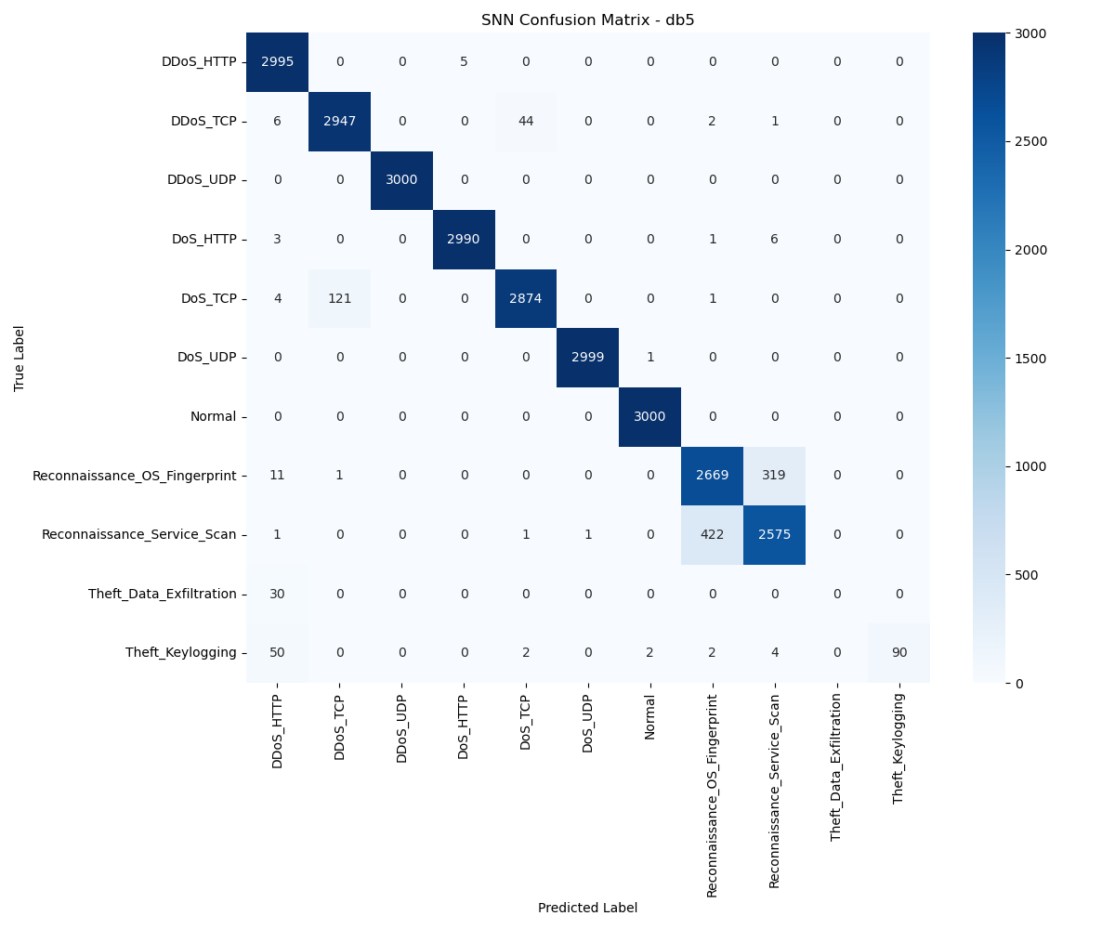
RESULTS AND DISCUSSION
Classification Matrix of SNN Model trained on DB5
The SNN model trained on DB5, it is observed from the classification matrix that both classes achieve high accuracy. The confusion matrix becomes mostly diagonal, indicating robust separation for well-represented classes, though rare classes like keylogging and data exfiltration remain challenging.

Slide 25
RESULTS AND DISCUSSION
Real-World Attack Evaluation and Prediction Quality
While the models look great on paper, real-time traffic reveals some gaps—many DoS and DDoS attacks end up grouped under a single label, and subtle categories like data exfiltration or keylogging often get missed.
This mostly happens because the Bot-IoT dataset is built in a controlled, lab setting, which doesn’t capture all the messy unpredictability seen in the real world.
To balance out rare attack types, we rely on synthetic data (via SMOTE), but this approach can’t fully mimic the complexity of actual, live threats.
These results really highlight the need for robust, ongoing validation with real traffic and continuous improvement of our datasets if we want the models to work reliably in the field.

Slide 26
LIMITATIONS AND FUTURE WORK
The main challenge comes from using the Bot-IoT dataset, which was built in a lab environment and doesn’t capture the true variety, timing, or unpredictability found in real networks.
Balancing the dataset with techniques like SMOTE helps handle underrepresented attacks, but still can’t fully reflect how new or rare attacks look in the wild.
When tested in real time, the models sometimes confuse similar attacks, showing the need for constant model updates and smarter, more representative data.
Looking ahead, using reinforcement learning and tools like Argus to generate custom, real-world datasets—and adding features like automated retraining and attack drift detection—will be key for making these systems work reliably in ever-changing IoT networks.

Slide 27
CONCLUSION
The SNN-based system, combined with ensemble classifiers, achieves over 96% detection accuracy on IoT attacks.
Covers the full pipeline from packet capture to real-time alerting and edge deployment.
Synthetic and lab-based data limits some real-world effectiveness, but overall results show strong potential.
Future work aims to make the system more adaptive by using reinforcement learning and custom, locally generated datasets.

Slide 28
LIST OF REFERENCES
Khaleefah, A. D., & Al-Mashhadi, H. M. (2023). "Detection of IoT Botnet Cyber Attacks using Machine Learning Algorithms." Informatica.
Koroniotis, et al. (2019). "Towards the development of realistic botnet dataset in the internet of things for network forensic analytics: Bot-iot dataset." Future Generation Computer Systems 100.
Rahman, T., et al. (2025). "A survey on intrusion detection system in IoT networks." Elsevier.​
Amine, M. S., et al. (2025). "Improved model for intrusion detection in the Internet of Things." Nature.​
Alosaimi, S., & Almutairi, S. M. (2023). An intrusion detection system using BOT-IoT. Applied Sciences.
Sharma, P., et al. (2025). "Leveraging AI for Intrusion Detection in IoT Ecosystems." IEEE.​
Qaddos, M., et al. (2024). "A novel intrusion detection framework for optimizing IoT security using hybrid CNN-GRU models." Nature.​
Wang, J., et al. (2024). "An efficient intrusion detection model based on Spiking Neural Networks." Nature.​
Yarga, S., Wood, D., et al. (2024). "Direct training high-performance deep spiking neural networks." Frontiers in Neuroscience.​
Rahman, P. M., et al. (2023). "Exploring spiking neural networks: A comprehensive analysis of models, performance, and limitations." PubMed.​
Manivannan, S., et al. (2024). "Recent endeavours in machine learning-powered intrusion detection systems for IoT." Elsevier.​

